Slide 1


SAP Full-Stack Developer training
ABAP on HANA, UI5 & Fiori, Analytics with OData
Anubhav Oberoy
Day – 15
Notes:
www.anubhavtrainings.com

Slide 2

Agenda – Day 15
Understanding CDS Security
Describing CDS Table Functions
Understanding Why we use CDS Table Function
--Break--
CDS-BOPF Integration
Describing Validation in ( Business Object ) BO
Implementation of Smart filter UX Application
Transactional UX App with CDS and BOPF
Notes:
www.anubhavtrainings.com

Slide 3
CDS Data Control Language ( DCL )
Declarative approach instead of coded
Based on CDS modeling objects and therefore part of the data-model
Authorizations are also pushed down to DB by extending the Open SQL SELECT statement
Authorizations are only defined once and automatically (re-) used everywhere
Classical approach
DCL approach
PFCG
<Code>
PFCG
<Code>
DCL
SQL
&
SQL
ABAP Authorization Check
CDS View
<Code>
<Code>
Notes:
www.anubhavtrainings.com

Slide 4





Authorizations for CDS Views
All CDS views which expose sensitive or data privacy and protection relevant data must be secured.
Access restriction on record level are expressed by roles in the Data Control Language (DCL).
Authorization enforcement of DCLs are automatically applied for direct ABAP SQL selects on their protected CDS views.
Authorization enforcement of DCLs are injected as additional filter criteria.
If multiple DCLs are defined for a single CDS view the access restrictions are combined by a logical OR (i.e. the access is less restricted than defined by the individual DCLs).
Notes:
www.anubhavtrainings.com

Slide 5

Exercise
CDS Security with DCL.
Notes:
www.anubhavtrainings.com

Slide 6
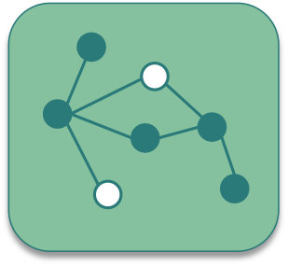
CDS Table Function
CDS Table Functions allow to use natively implemented database-functions in SAP HANA DB directly from CDS.
Notes:
www.anubhavtrainings.com

Slide 7

Why we need CDS Table Function
CDS is an open extension of classical DDIC views:
Support for AnyDB
Optimal integration into DDIC and ABAP
Supports about 90 % of SQL features
But: no access to specific HANA features
Required: Some scenarios require selective measure (“Breakout Scenario” for HANA-only applications)
Highest performance requirements e.g. with complex calculations
Use of database / analytical engine specific functions required
Open SQL and CDS views do not yet offer functionality to solve the problem
Notes:
www.anubhavtrainings.com

Slide 8
Necessary part of CDS Table Function
Table function definition
Parameter list
Return Parameter
Reference to implementing method
Runtime for table function
Runs stored SQL-script procedure generated from AMDP on database tables
ABAP Managed Database Procedure
SAP HANA Database
DDL Source
AMDP Implementation
Includes SQL-script function body
Notes:
www.anubhavtrainings.com

Slide 9

Key Feature of Table Function
They are implemented in HANA SQLScript via AMDP methods
Signature is defined in DDL source (importing parameters and return columns)
They can be consumed by Open SQL and ABAP CDS like other DDIC artifacts (i.e. DB tables, classical DDIC views, CDS views ...)
The SQLScript implementation is handled by the AMDP framework (lifecycle, tool support, extensibility etc.)
DDL source can be activated before the implementing AMDP method exists.
Exercise
CDS Table Function Code
Notes:
www.anubhavtrainings.com

Slide 10

Break
Notes:
www.anubhavtrainings.com

Slide 11

CDS BOPF
The Business Object Processing Framework is an ABAP OO-based framework that provides a set of generic services and functionalities to speed up, standardize, and modularize your development. BOPF manages the entire life cycle of your business objects and covers all aspects of your business application development.
Notes:
www.anubhavtrainings.com

Slide 12
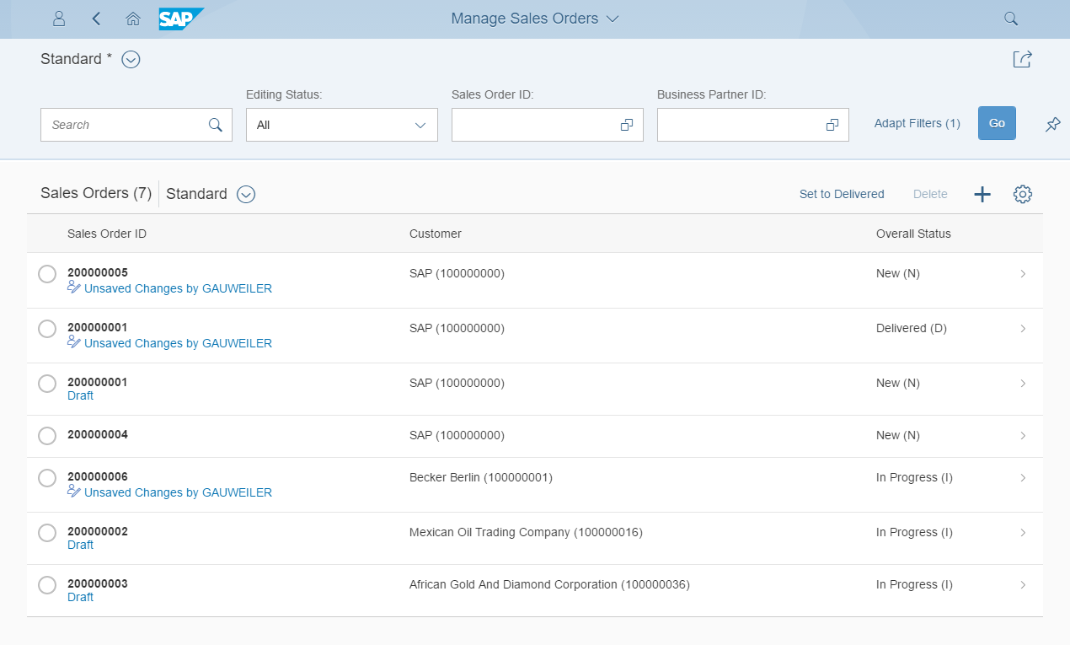
Development flow & Artifacts
BOPF (Business Object Processing Framework) is a framework for working with the BO (Business Objects). BO is a representation of a type of uniquely identifiable business entities described by a structural model, an internal process model, and one or more service interfaces.
consume
SAP Fiori Elements, …
OData Service
Consumption view
Consumption view
Search Object(s)
Core Data Services
generate / publish
Subnode consumption view
Subnode consumption view
Subnode consumption view
Subnode consumption view
Metadata Extension
enrich
Data Definition
generate
BOPF Business Object
implement
Custom ABAP Business Logic
CDS metadata extensions can currently only be created for CDS views. A CDS metadata extension is a CDS object that is defined and transported in a separate CDS source code.
Draft table
Draft table
Database table
Draft table
Notes:
www.anubhavtrainings.com

Slide 13
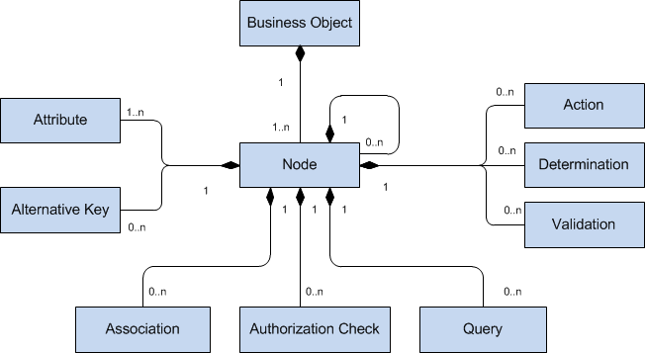
Business Object
The business objects are the basic units of the BOPF-based programming model. Business applications or processes operate on certain business objects. A business object is represented as a hierarchical tree of nodes. A single node includes a set of semantically related business object data and the corresponding business logic. On the technical level, each node is implemented with a regular Dictionary table, where each node instance corresponds to a single table entry (table rows). Nodes, attributes, and alternative keys set up the data part of a business object. Again from a technical viewpoint, attributes form the columns of the table. A node serves as an anchor point for connecting the business logic of the business object.
Notes:
www.anubhavtrainings.com

Slide 14
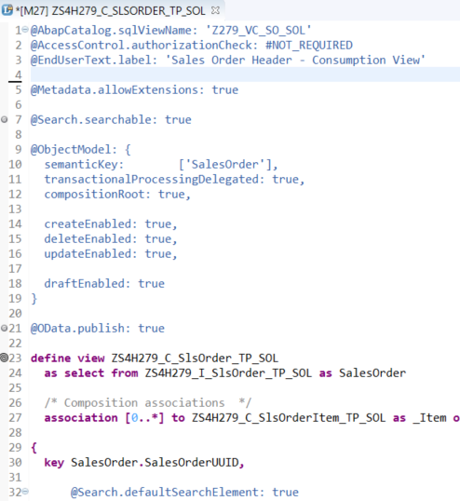
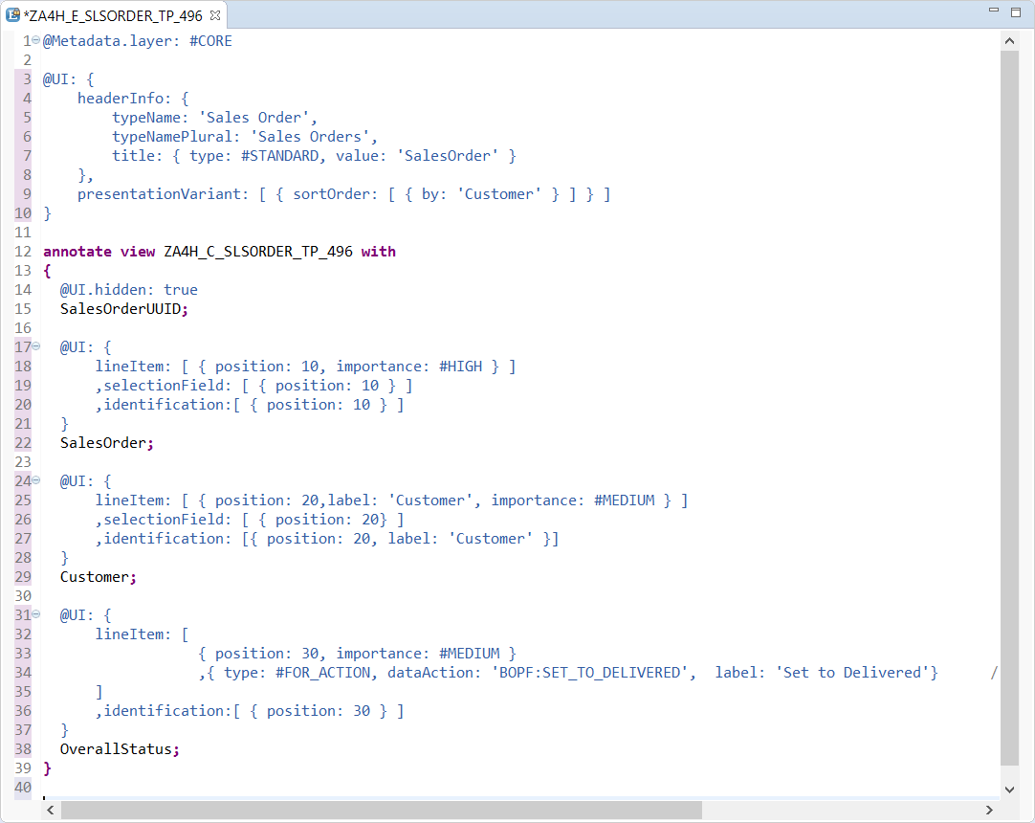
Transactional UX App with CDS & BOPF
With Draft Functionality
Access Control
UI semantic
Search enablement
Transactional enablement
OData exposure
Notes:
www.anubhavtrainings.com

Slide 15

Exercise
CDS BOPF Scenario
Notes:
www.anubhavtrainings.com

Slide 16

End of Day 15
Notes:
www.anubhavtrainings.com

Slide 17

Questions
Notes:
www.anubhavtrainings.com

Slide 18

Anubhav Oberoy
Notes:
www.anubhavtrainings.com

Slide 19


We’re committed to empower you to be
Most Desirable Resource
through powerful training solutions.
We build the workforce of the future.
250+
Corporate Clients
30,000+
Learners Trained
25000+
Learners Placed
FREE WEBINARS
Sign up for free webinars with industry experts every fortnight!
Enroll Now!
Contact us today!
https://anubhavtrainings.com/
Notes:
www.anubhavtrainings.com

Slide 20




More from AnubhavTrainings.com
Notes:
www.anubhavtrainings.com

